Slide 1

ECB1204 – ANALOG INTEGRATED CIRCUIT DESIGN DEVELOPMENT OF AN IC-BASED VIBRATION DETECTION AND MONITORING SYSTEMS
Presented by:
MOHAMED BASITH M (2303811710621065)
POSHITH KUMAR G (2303811710621078)
RAJARAJAN G (2303811710621084)
Under the Guidance of
Mrs.G.KEERTHANA, M.E .,
ASSISTANT PROFESSOR
ECE

Slide 2
OUTLINE
ABSTRACT
INTRODUCTION
PROBLEM STATEMENT
OBJECTIVE
HARDWARE MODULE
RESULTS AND DISCUSSION
ADVANTAGES AND APPLICATIONS
CONCLUSION
FUTURE ENHANCEMENT

Slide 3
ABSTRACT
The vibration detector is an innovative analog circuit designed to sense vibrations and provide real-time visual feedback using an LED. This project employs a simple yet effective mechanism where a vibration analyser (a nail mounted on a spring) converts mechanical motion into an electrical signal. The NE555 timer, configured in monostable mode, processes this signal to trigger an LED, which glows to indicate vibrations. The system demonstrates practical applications of analog electronic components in detecting environmental or mechanical disturbances. It is cost-effective, straightforward, and serves as an excellent learning tool for understanding analog electronics.

Slide 4
INTRODUCTION
Vibrations, whether in machinery, structures, or natural phenomena, are critical indicators of underlying issues or events. Detecting and monitoring these vibrations can prevent potential failures, enhance safety, and ensure operational efficiency. This project leverages analog circuitry to create a basic yet functional vibration detection system. Using the NE555 timer as the core component, this system detects mechanical disturbances and provides an immediate LED indication. The simplicity of the design makes it ideal for applications in educational environments and small-scale monitoring systems while fostering hands-on understanding of analog electronics principles.

Slide 5
PROBLEM STATEMENT
Vibrations, if undetected, can lead to significant mechanical failures, safety risks, or missed environmental indicators. There is a need for a low-cost, easily implementable solution to detect vibrations in real time and provide immediate feedback. The challenge lies in designing a system that effectively senses and processes vibrations using readily available analog components.

Slide 6
OBJECTIVE
The vibration sensing system reliably detects mechanical vibrations and provides real-time feedback using an NE555 timer IC. Configured in monostable mode, the timer processes signals from a vibration analyser, which converts mechanical disturbances into electrical inputs. These signals trigger the NE555 to activate an LED, visually indicating vibrations. This project demonstrates the practical application of analog electronics, offering hands-on learning about signal processing and circuit design using simple, cost-effective components.

Slide 7
HARDWARE MODULE
NE555 Timer IC:
Configured in monostable mode, the NE555 generates a single output pulse whenever triggered by the input signal from the vibration analyser. This pulse is used to illuminate the LED momentarily.
Vibration Analyser:
A mechanical system consisting of a nail mounted on a spring acts as the vibration sensor. When vibrations occur, the nail moves and contacts another point, completing an electrical circuit and triggering the timer.

Slide 8
HARDWARE MODULE
LED:
The LED lights up to visually indicate the presence of vibrations, providing immediate feedback to users.
330-ohm Resistor:
This component limits the current flowing through the LED, protecting it from damage.
9V Battery:
Supplies the required voltage to power the circuit components.

Slide 9
HARDWARE MODULE
Breadboard:
Facilitates easy assembly and testing of the circuit without soldering.

Slide 10
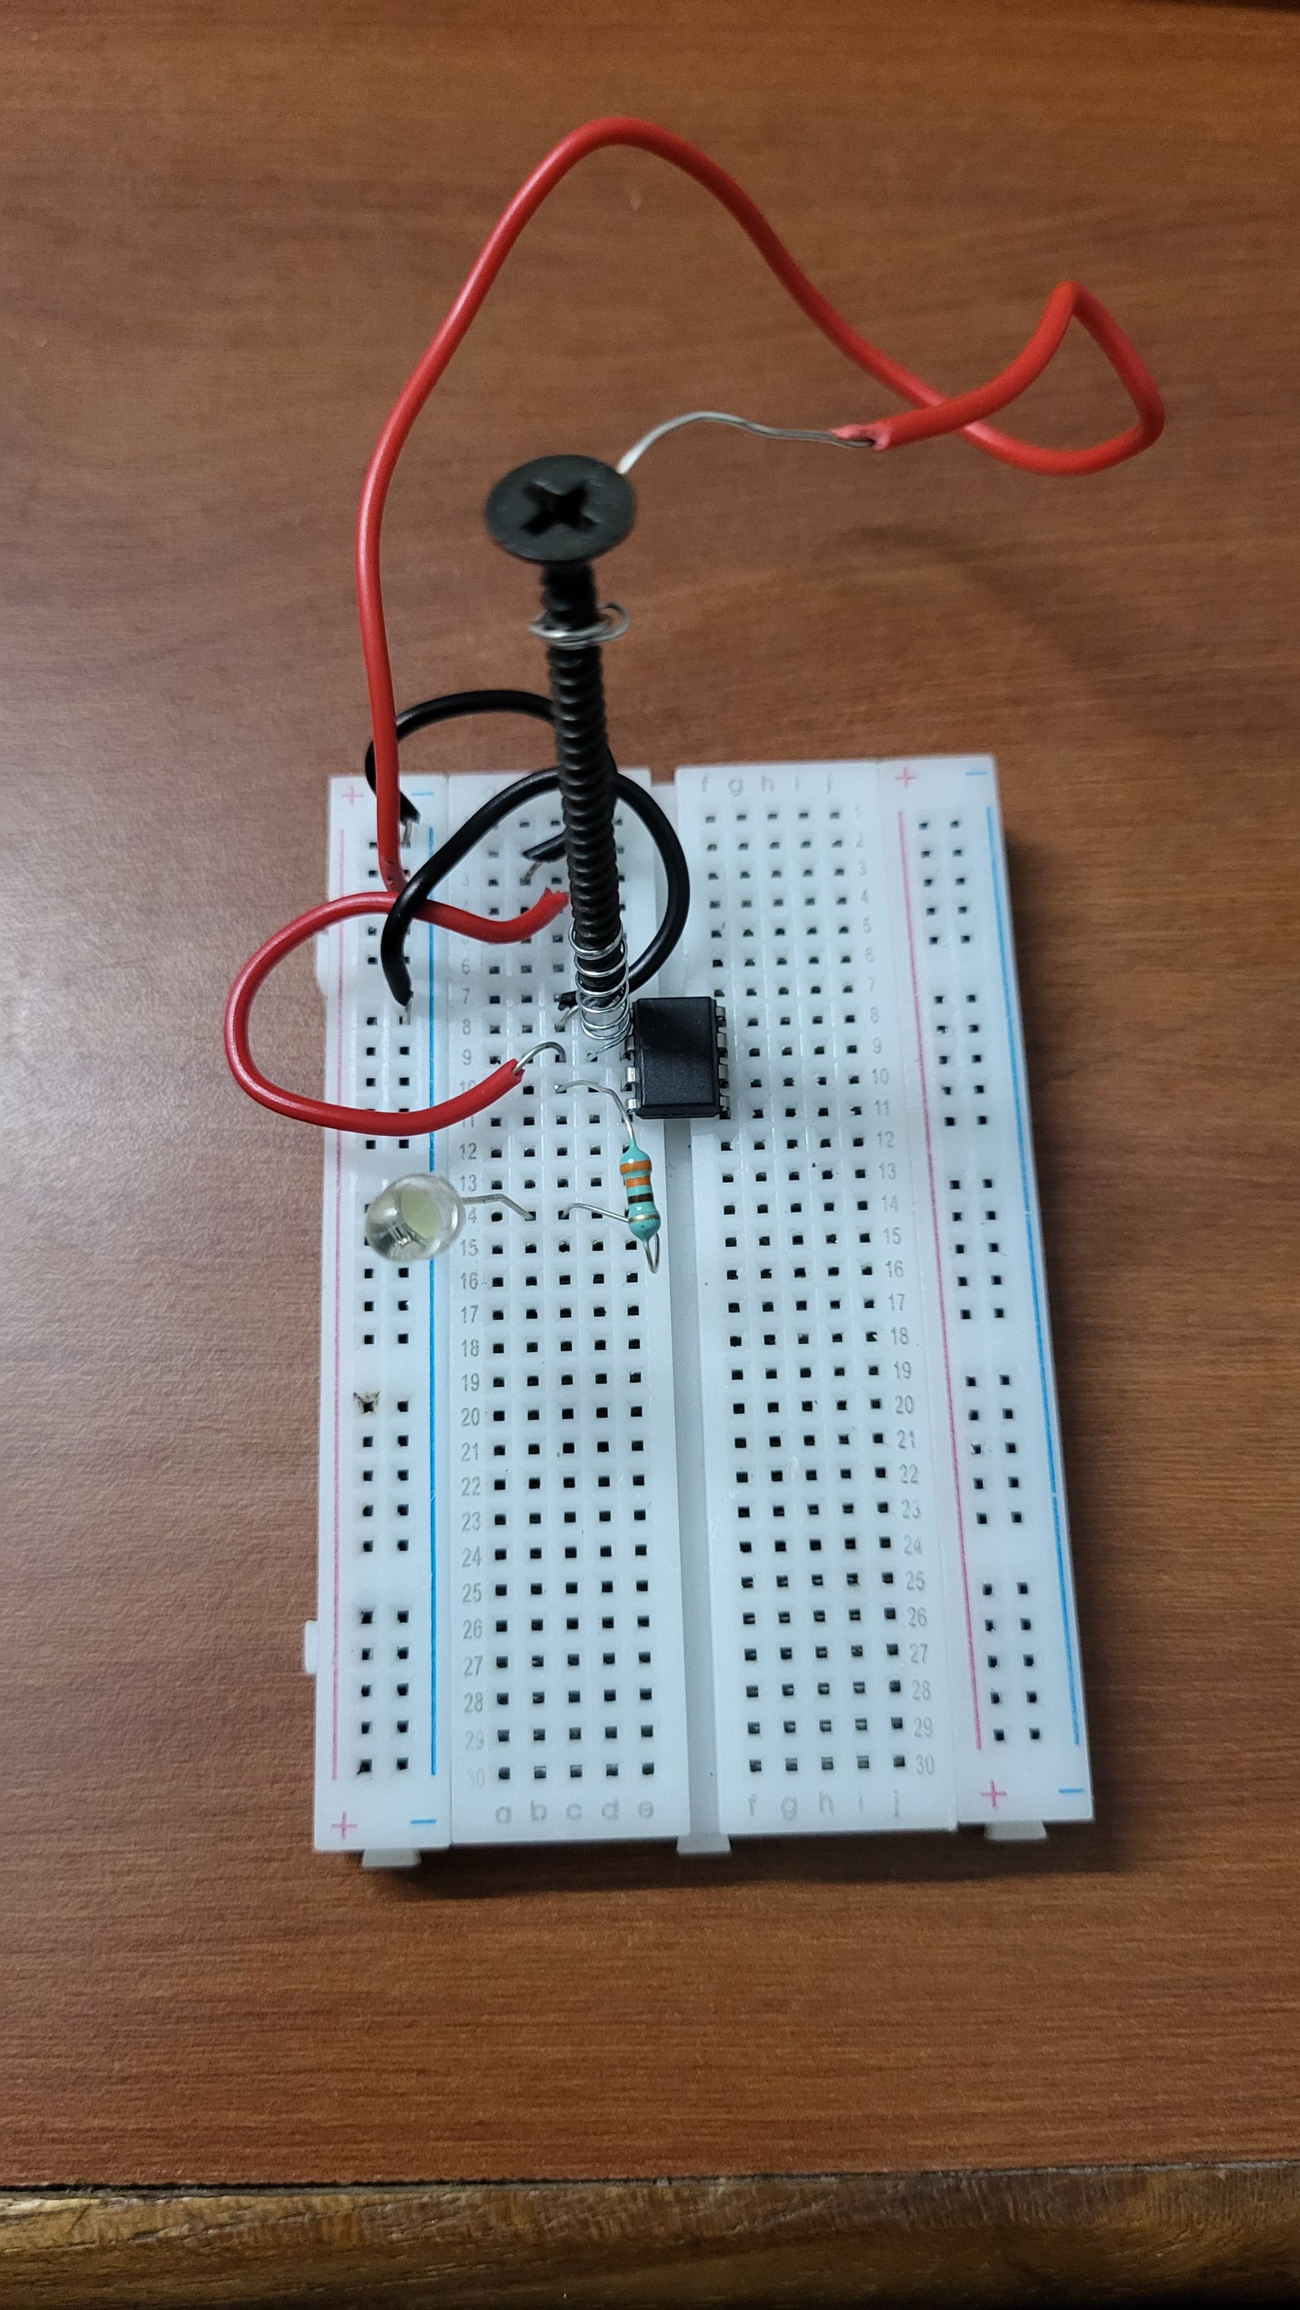
RESULTS AND DISCUSSION
The vibration detector circuit effectively senses mechanical disturbances. When vibrations occur, the nail in the spring mechanism moves to complete the circuit, sending a signal to the NE555 timer.

Slide 11
RESULTS AND DISCUSSION
The timer then triggers the LED, which glows briefly to indicate the vibration. The system responds consistently to varying intensities of vibrations, demonstrating its reliability. Factors such as the sensitivity of the vibration analyser and the timer configuration impact the system's accuracy and responsiveness. Overall, the circuit performs efficiently, meeting its design objectives.

Slide 12
ADVANTAGES AND APPLICATIONS
ADVANTAGES
Low-Cost Solution: Uses inexpensive and readily available components.
Ease of Implementation: Simple circuit design suitable for beginners and educational purposes.
Low Power Consumption: Operates efficiently on a 9V battery.
Customizable Sensitivity: Can be adjusted for different vibration levels with minor modifications.

Slide 13
ADVANTAGES AND APPLICATIONS
APPLICATIONS
Industrial Monitoring: Detects vibrations in machinery to prevent malfunctions.
Security Systems: Alerts for unauthorized movements or disturbances.
Educational Projects: Demonstrates analog electronics principles in academic settings.
Earthquake Models: Simulates and detects small-scale seismic activities.

Slide 14
CONCLUSION
The vibration sensing system effectively demonstrates the application of analog electronics in detecting mechanical disturbances and providing real-time feedback. Using an NE555 timer in monostable mode and a nail-spring vibration analyser, the system converts vibrations into electrical signals, triggering an LED to visually indicate the event. This cost-effective and reliable design highlights the practical utility of simple analog circuits while offering a hands-on learning experience in signal processing and circuit design.
Additionally, the project lays the groundwork for future enhancements, such as improved sensitivity, multimodal feedback, data logging, and wireless transmission, making it a versatile and scalable solution for industrial, educational, and security applications.

Slide 15
FUTURE ENHANCEMENT
Adjustable Sensitivity: Integrate a potentiometer to fine-tune vibration sensitivity for diverse applications.
Multimodal Feedback: Add a buzzer for audible alerts alongside the LED.
Data Recording: Introduce a microcontroller to log vibration events for analysis.
Remote Monitoring: Incorporate wireless modules to transmit data to a remote device.

Slide 16
THANK YOU

